Slide 1

Conflict-Aware Event-Participant Arrangement
Jieying She, Yongxin Tong, Lei Chen, Caleb Chen Cao
The Hong Kong University of Science and Technology

Slide 2
Outline
1. Introduction
2. Problem Definition
3. Algorithms
4. Experiments
5. Conclusion

Slide 3

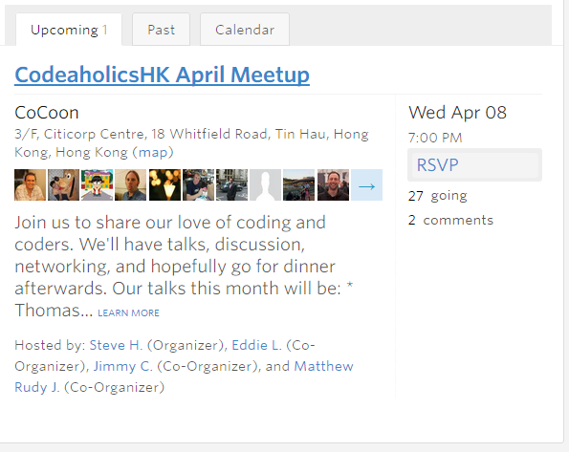
Introduction: Event-Based Social Network (EBSN)
A snapshot of Meetup.com

Slide 4



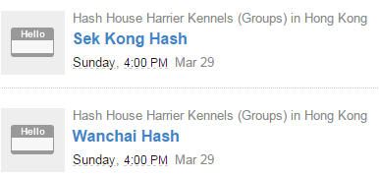
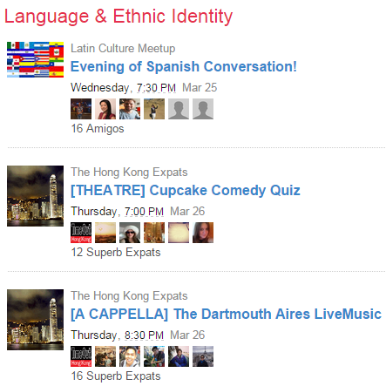

Slide 5
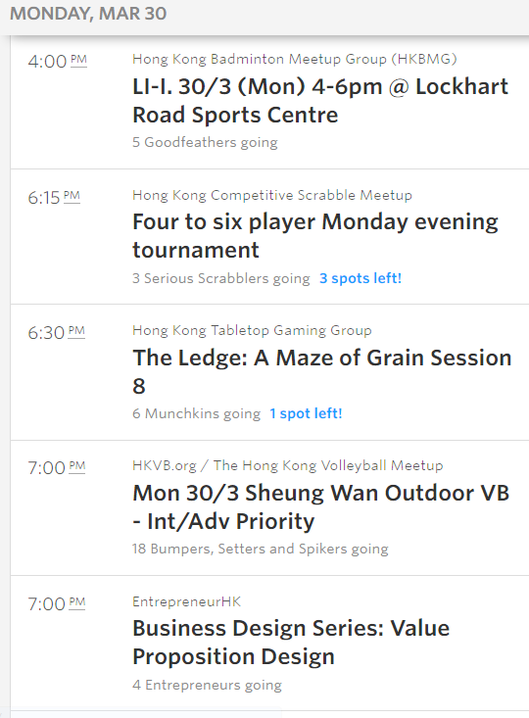





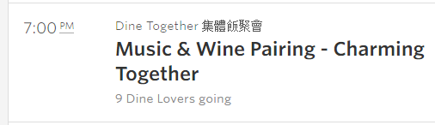
Tabletop Game
Word Game
Sports
Gathering
Tabletop Game
Gathering
Tabletop Game
Word Game
Business
Gathering
Volleyball
Word Game

Slide 6
Can we find an arrangement among the events and users to satisfy most parties’ interests?
Can we satisfy the following real-world constraints?
Capacity of events and users
Conflicts of events

Slide 7
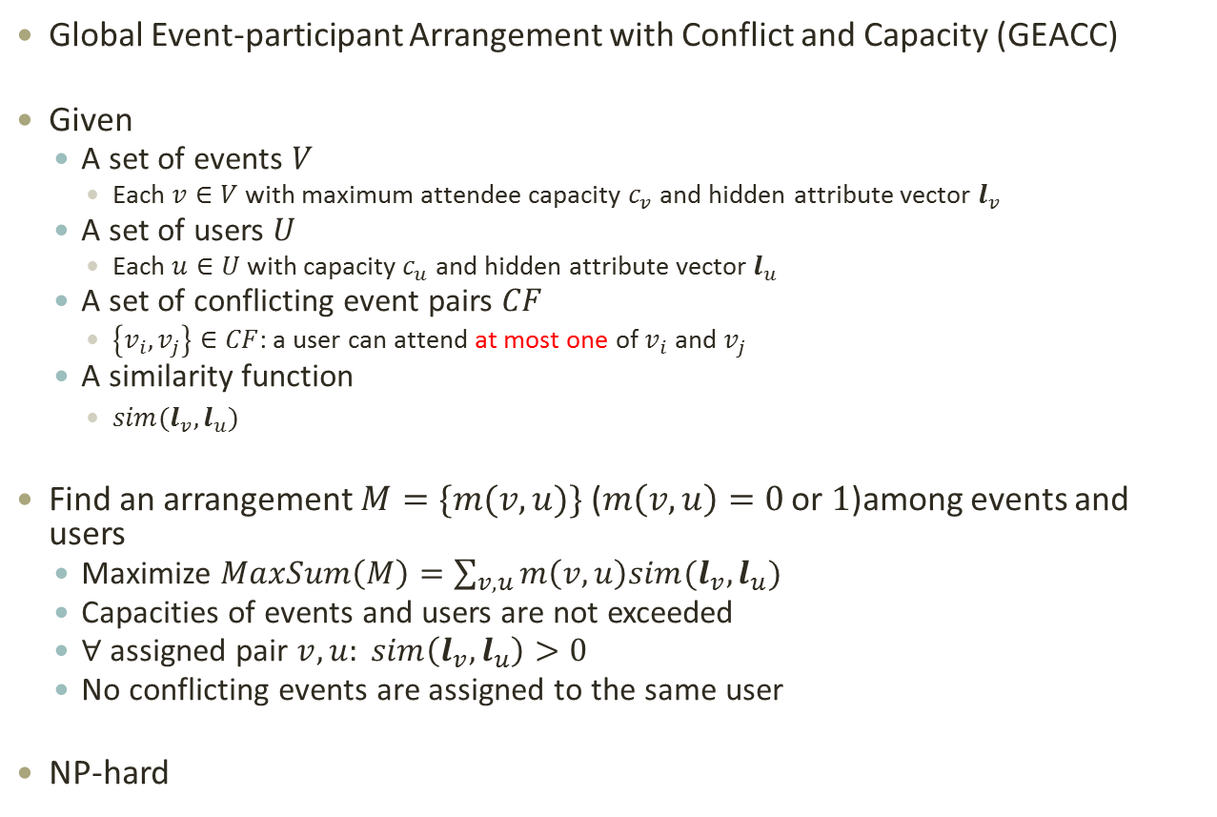
Problem Definition
Global Event-participant Arrangement with Conflict and Capacity (GEACC)
Given
A set of events $V$
Each $v∈V$ with maximum attendee capacity $c_{v}$ and hidden attribute vector $l_{v}$
A set of users $U$
Each $u∈U$ with capacity $c_{u}$ and hidden attribute vector $l_{u}$
A set of conflicting event pairs $CF$
$\left\{v_{i},v_{j}\right\}∈CF$: a user can attend at most one of $v_{i}$ and $v_{j}$
A similarity function
$sim(l_{v}, l_{u})$
Find an arrangement $M=\{m(v,u)\}$ ($m\left(v,u\right)=0$ or $1$)among events and users
Maximize $MaxSum\left(M\right)=\sum_{v,u}{m\left(v,u\right)sim(l_{v}, l_{u})}$
Capacities of events and users are not exceeded
$∀$assigned pair $v,u: sim\left(l_{v}, l_{u}\right)>0$
No conflicting events are assigned to the same user
NP-hard

Slide 8
Algorithms: (1)MinCostFlow-GEACC
Basic idea
1. Construct a flow network
2. Min-cost flow →a temporary arrangement
3. Resolve conflicts

Slide 9

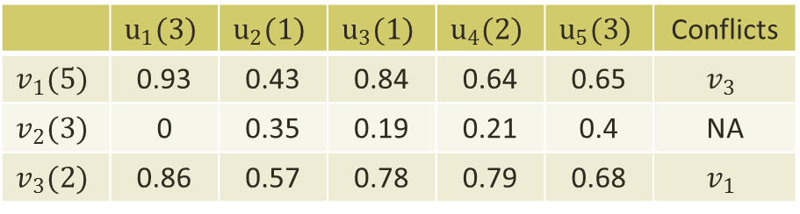









Algorithms: (1)MinCostFlow-GEACC
Basic idea
1. Construct a flow network
 | $$u_{1}(3)$$ | $$u_{2}(1)$$ | $$u_{3}(1)$$ | $$u_{4}(2)$$ | $$u_{5}(3)$$ | Conflicts
$$v_{1}(5)$$ | 0.93 | 0.43 | 0.84 | 0.64 | 0.65 | $$v_{3}$$
$$v_{2}(3)$$ | 0 | 0.35 | 0.19 | 0.21 | 0.4 | NA
$$v_{3}(2)$$ | 0.86 | 0.57 | 0.78 | 0.79 | 0.68 | $$v_{1}$$
cost=0.07
cap.=1
$$u_{1}$$
cost=0
cap.=5
$$v_{1}$$
$$u_{2}$$
$$s$$
$$v_{2}$$
$$u_{3}$$
$$t$$
cost=0
cap.=2
$$u_{4}$$
$$v_{3}$$
cost=0
cap.=3
cost=0.32
cap.=1
$$u_{5}$$

Slide 10






















Algorithms: (1)MinCostFlow-GEACC
Basic idea
2. Min-cost flow →a temporary arrangement
Send each flow $Δ∈\{Δ_{min},Δ_{min}+1,⋯,Δ_{max}\}$
$Δ_{min}=\min{\{\left|V\right|,|U|\}}$, $Δ_{max}=\min{\{\sum_{v}{c_{v},\sum_{u}{c_{u}}}\}}$
 | $$u_{1}(3)$$ | $$u_{2}(1)$$ | $$u_{3}(1)$$ | $$u_{4}(2)$$ | $$u_{5}(3)$$ | Conflicts
$$v_{1}(5)$$ | 0.93 | 0.43 | 0.84 | 0.64 | 0.65 | $$v_{3}$$
$$v_{2}(3)$$ | 0 | 0.35 | 0.19 | 0.21 | 0.4 | NA
$$v_{3}(2)$$ | 0.86 | 0.57 | 0.78 | 0.79 | 0.68 | $$v_{1}$$
$$Δ=10$$
$$u_{1}$$
$$u_{1}$$
flow=5
$$v_{1}$$
flow=3
$$flow\left(v,u\right)=1$$
$$sim\left(l_{v}, l_{u}\right)>0$$
$$v_{1}$$
$$u_{2}$$
$$u_{2}$$
flow=3
$$v_{2}$$
$$u_{3}$$
$$s$$
$$v_{2}$$
$$u_{3}$$
$$t$$
flow=2
flow=2
$$u_{4}$$
$$u_{4}$$
$$v_{3}$$
$$v_{3}$$
flow=3
$$u_{5}$$
$$u_{5}$$

Slide 11










Algorithms: (1)MinCostFlow-GEACC
Approximation ratio:
$$\frac{1}{\max{c_{u}}}$$
Basic idea
3. Resolve conflicts
 | $$u_{1}(3)$$ | $$u_{2}(1)$$ | $$u_{3}(1)$$ | $$u_{4}(2)$$ | $$u_{5}(3)$$ | Conflicts
$$v_{1}(5)$$ | 0.93 | 0.43 | 0.84 | 0.64 | 0.65 | $$v_{3}$$
$$v_{2}(3)$$ | 0 | 0.35 | 0.19 | 0.21 | 0.4 | NA
$$v_{3}(2)$$ | 0.86 | 0.57 | 0.78 | 0.79 | 0.68 | $$v_{1}$$
$$u_{1}$$
$$v_{1}$$
$$u_{2}$$
$$MaxSum=4.13$$
$$v_{2}$$
$$u_{3}$$
$$u_{4}$$
$$v_{3}$$
$$u_{5}$$

Slide 12





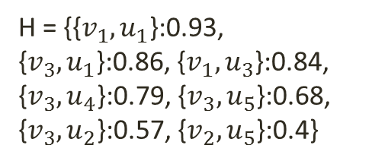




Algorithms: (2)Greedy-GEACC
Basic idea
Greedily add the most similar unmatched pair
 | $$u_{1}(3)$$ | $$u_{2}(1)$$ | $$u_{3}(1)$$ | $$u_{4}(2)$$ | $$u_{5}(3)$$ | Conflicts
$$v_{1}(5)$$ | 0.93 | 0.43 | 0.84 | 0.64 | 0.65 | $$v_{3}$$
$$v_{2}(3)$$ | 0 | 0.35 | 0.19 | 0.21 | 0.4 | NA
$$v_{3}(2)$$ | 0.86 | 0.57 | 0.78 | 0.79 | 0.68 | $$v_{1}$$
$$u_{1}$$
$$v_{1}$$
$$u_{2}$$
H = {{$v_{1},u_{1}$}:0.93, {$v_{3},u_{1}$}:0.86, {$v_{1},u_{3}$}:0.84, {$v_{3},u_{4}$}:0.79, {$v_{3},u_{5}$}:0.68, {$v_{3},u_{2}$}:0.57, {$v_{2},u_{5}$}:0.4}
$$v_{2}$$
$$u_{3}$$
$$u_{4}$$
$$v_{3}$$
$$u_{5}$$

Slide 13
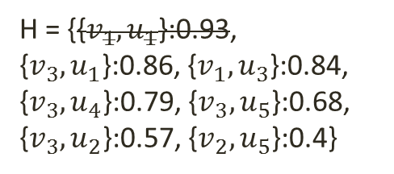
Algorithms: (2)Greedy-GEACC
Basic idea
Greedily add the most similar unmatched pair
 | $$u_{1}(3)$$ | $$u_{2}(1)$$ | $$u_{3}(1)$$ | $$u_{4}(2)$$ | $$u_{5}(3)$$ | Conflicts
$$v_{1}(5)$$ | 0.93 | 0.43 | 0.84 | 0.64 | 0.65 | $$v_{3}$$
$$v_{2}(3)$$ | 0 | 0.35 | 0.19 | 0.21 | 0.4 | NA
$$v_{3}(2)$$ | 0.86 | 0.57 | 0.78 | 0.79 | 0.68 | $$v_{1}$$
$$u_{1}$$
$$v_{1}$$
$$u_{2}$$
H = {{$v_{1},u_{1}$}:0.93, {$v_{3},u_{1}$}:0.86, {$v_{1},u_{3}$}:0.84, {$v_{3},u_{4}$}:0.79, {$v_{3},u_{5}$}:0.68, {$v_{3},u_{2}$}:0.57, {$v_{2},u_{5}$}:0.4}
$$v_{2}$$
$$u_{3}$$
$$u_{4}$$
$$v_{3}$$
$$u_{5}$$

Slide 14
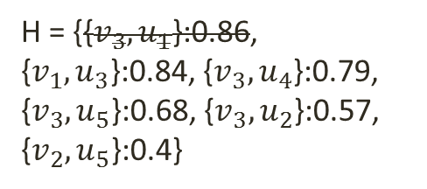
Algorithms: (2)Greedy-GEACC
Basic idea
Greedily add the most similar unmatched pair
 | $$u_{1}(3)$$ | $$u_{2}(1)$$ | $$u_{3}(1)$$ | $$u_{4}(2)$$ | $$u_{5}(3)$$ | Conflicts
$$v_{1}(5)$$ | 0.93 | 0.43 | 0.84 | 0.64 | 0.65 | $$v_{3}$$
$$v_{2}(3)$$ | 0 | 0.35 | 0.19 | 0.21 | 0.4 | NA
$$v_{3}(2)$$ | 0.86 | 0.57 | 0.78 | 0.79 | 0.68 | $$v_{1}$$
$$u_{1}$$
$$v_{1}$$
$$u_{2}$$
H = {{$v_{3},u_{1}$}:0.86, {$v_{1},u_{3}$}:0.84, {$v_{3},u_{4}$}:0.79, {$v_{3},u_{5}$}:0.68, {$v_{3},u_{2}$}:0.57, {$v_{2},u_{5}$}:0.4}
$$v_{2}$$
$$u_{3}$$
$$u_{4}$$
$$v_{3}$$
$$u_{5}$$

Slide 15
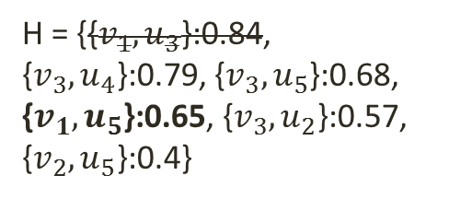
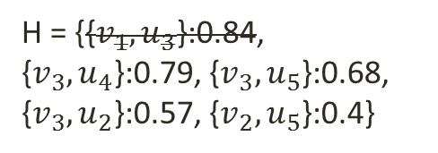
Algorithms: (2)Greedy-GEACC
Basic idea
Greedily add the most similar unmatched pair
 | $$u_{1}(3)$$ | $$u_{2}(1)$$ | $$u_{3}(1)$$ | $$u_{4}(2)$$ | $$u_{5}(3)$$ | Conflicts
$$v_{1}(5)$$ | 0.93 | 0.43 | 0.84 | 0.64 | 0.65 | $$v_{3}$$
$$v_{2}(3)$$ | 0 | 0.35 | 0.19 | 0.21 | 0.4 | NA
$$v_{3}(2)$$ | 0.86 | 0.57 | 0.78 | 0.79 | 0.68 | $$v_{1}$$
$$u_{1}$$
$$v_{1}$$
$$u_{2}$$
H = {{$v_{1},u_{3}$}:0.84, {$v_{3},u_{4}$}:0.79, {$v_{3},u_{5}$}:0.68, {$v_{3},u_{2}$}:0.57, {$v_{2},u_{5}$}:0.4}
H = {{$v_{1},u_{3}$}:0.84, {$v_{3},u_{4}$}:0.79, {$v_{3},u_{5}$}:0.68, {$v_{1},u_{5}$}:0.65, {$v_{3},u_{2}$}:0.57, {$v_{2},u_{5}$}:0.4}
$$v_{2}$$
$$u_{3}$$
$$u_{4}$$
$$v_{3}$$
$$u_{5}$$

Slide 16



Algorithms: (2)Greedy-GEACC
Approximation ratio:
$$\frac{1}{1+max{c_{u}}}$$
Basic idea
Greedily add the most similar unmatched pair
 | $$u_{1}(3)$$ | $$u_{2}(1)$$ | $$u_{3}(1)$$ | $$u_{4}(2)$$ | $$u_{5}(3)$$ | Conflicts
$$v_{1}(5)$$ | 0.93 | 0.43 | 0.84 | 0.64 | 0.65 | $$v_{3}$$
$$v_{2}(3)$$ | 0 | 0.35 | 0.19 | 0.21 | 0.4 | NA
$$v_{3}(2)$$ | 0.86 | 0.57 | 0.78 | 0.79 | 0.68 | $$v_{1}$$
$$u_{1}$$
$$v_{1}$$
$$u_{2}$$
H = ({$v_{2},u_{3}$})
$$v_{2}$$
$$u_{3}$$
$$MaxSum=4.28$$
$$u_{4}$$
$$v_{3}$$
$$u_{5}$$

Slide 17

Algorithms: (3)Prune-GEACC
An exact algorithm for small dataset
Search the space in increasing order of $sim(l_{v},l_{u})$ values and calculate an upper bound to do the pruning

Slide 18
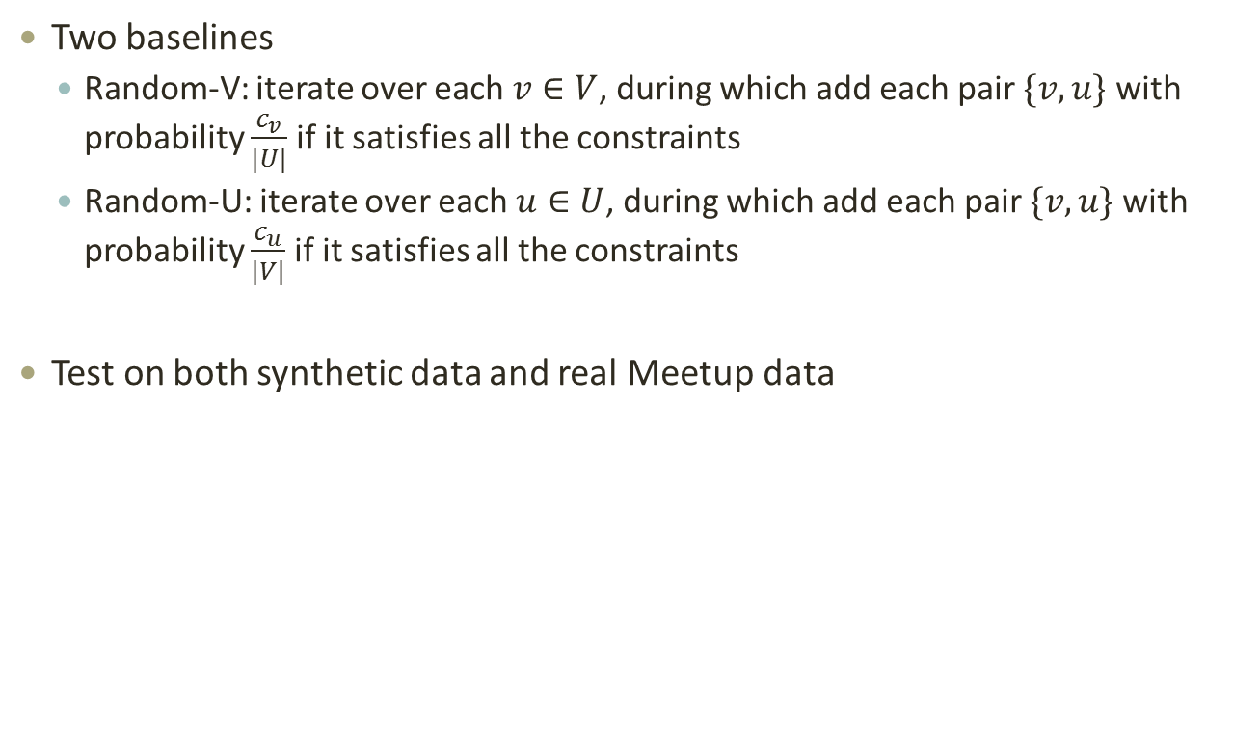
Experiments
Two baselines
Random-V: iterate over each $v∈V$, during which add each pair $\{v,u\}$ with probability $\frac{c_{v}}{|U|}$ if it satisfies all the constraints
Random-U: iterate over each $u∈U$, during which add each pair $\{v,u\}$ with probability $\frac{c_{u}}{|V|}$ if it satisfies all the constraints
Test on both synthetic data and real Meetup data

Slide 19
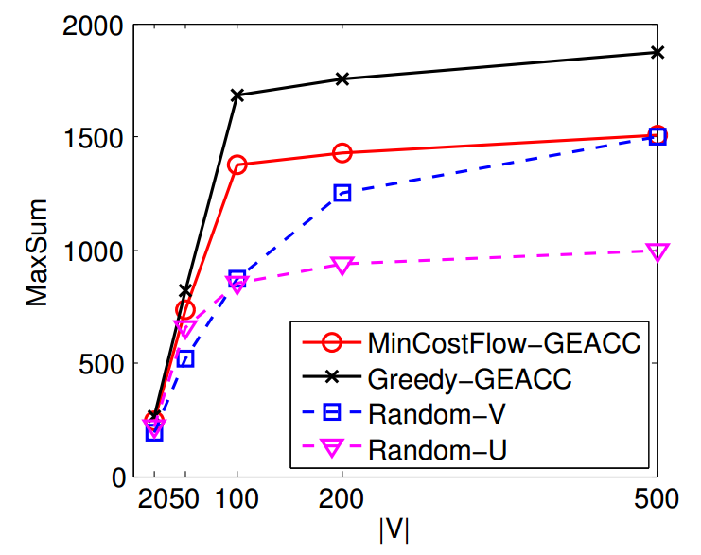
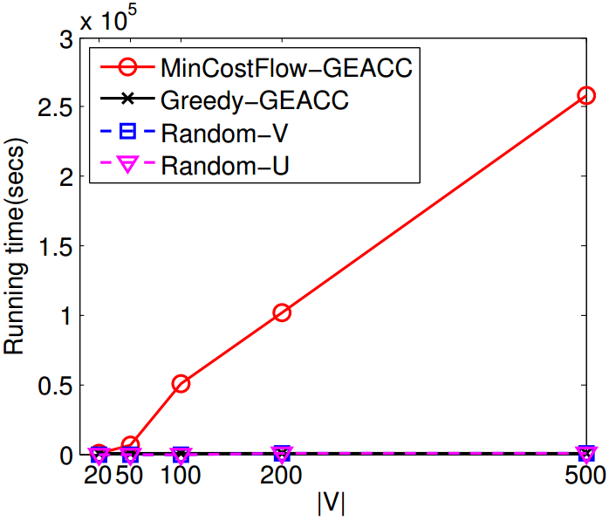
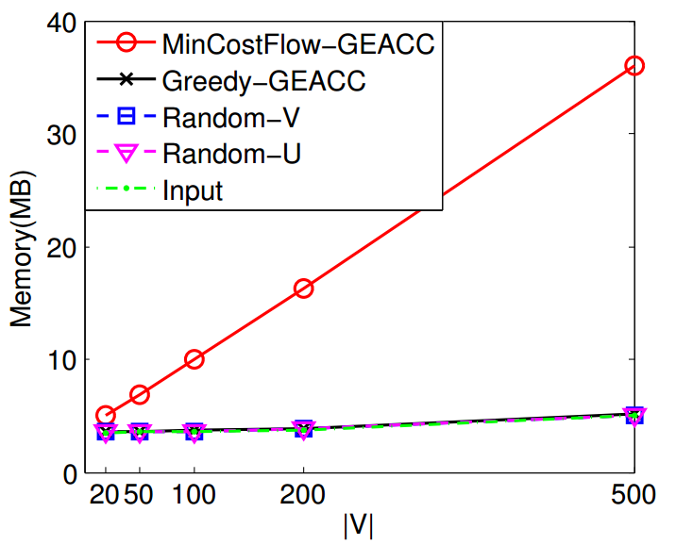


Experiments: Vary $|V|$
Default: $\left|U\right|=1000$, 25% events are conflicting

Slide 20
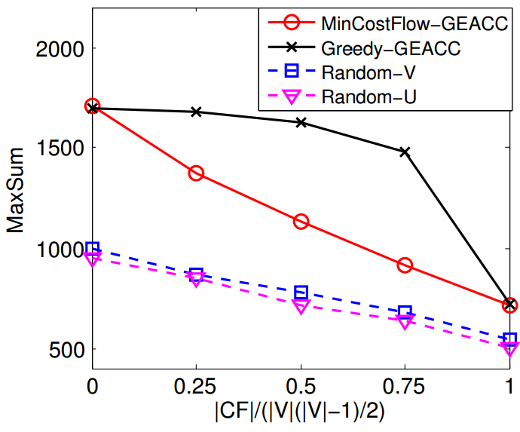
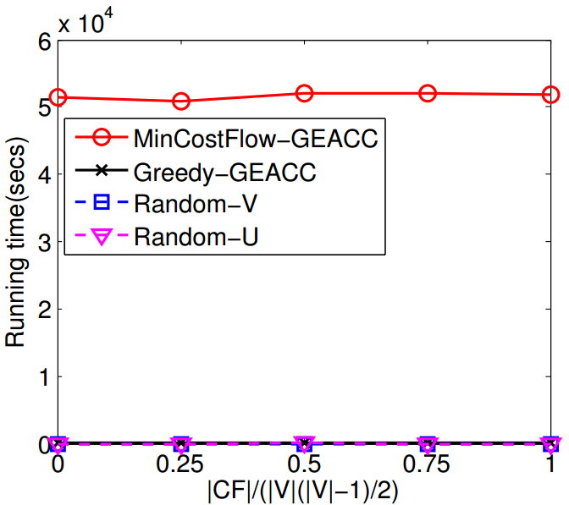
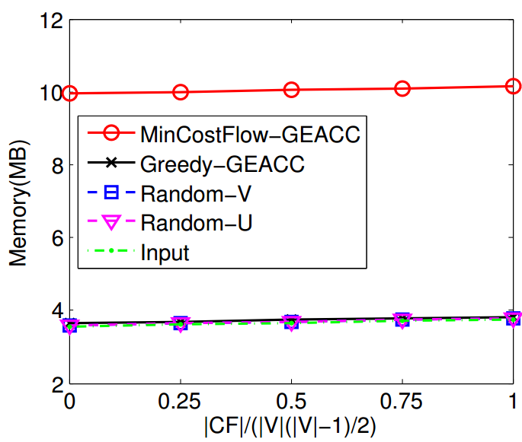


Experiments: Vary $\left|CF\right|/(|V|(\left|V\right|−1)/2)$
Default: $\left|V\right|=100,\left|U\right|=1000$

Slide 21
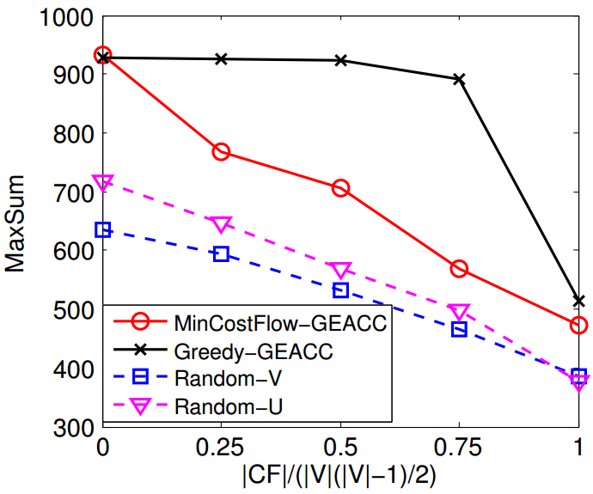
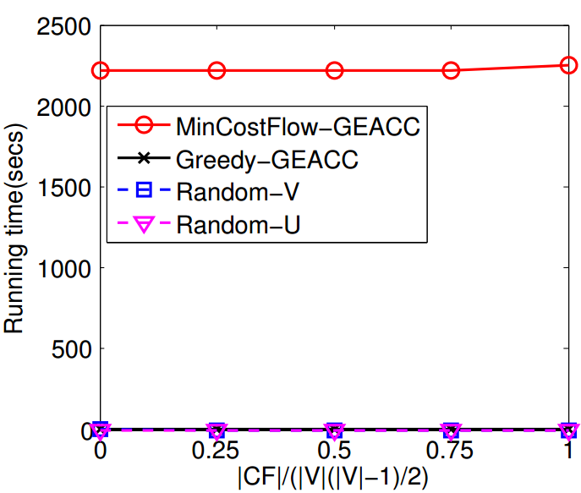
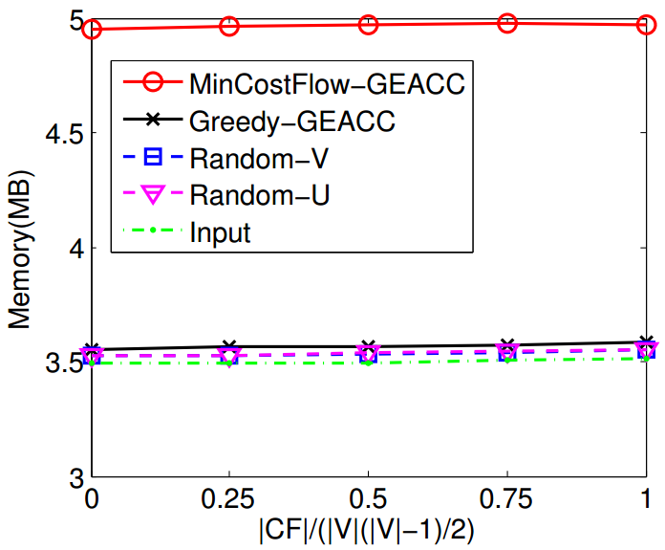

Experiments: Real Data
Auckland: $\left|V\right|=37,\left|U\right|=569$

Slide 22
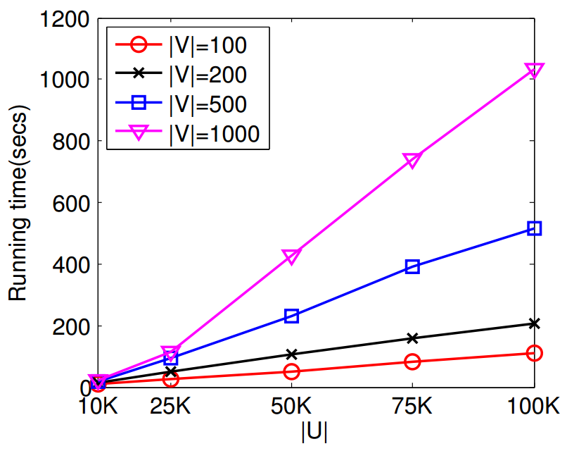
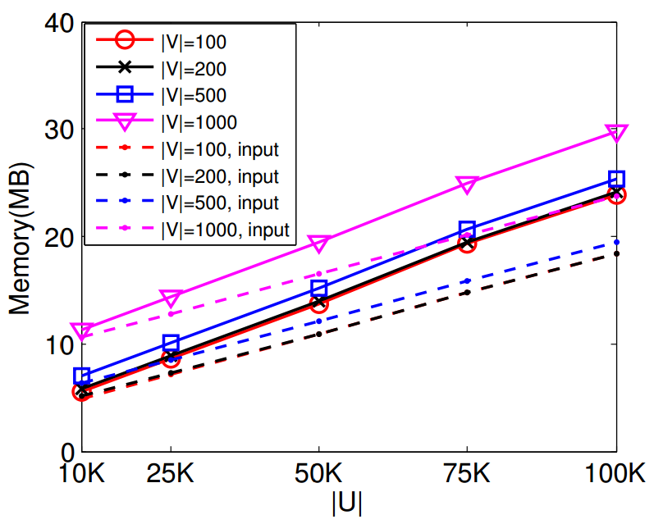
Experiments: Scalability

Slide 23
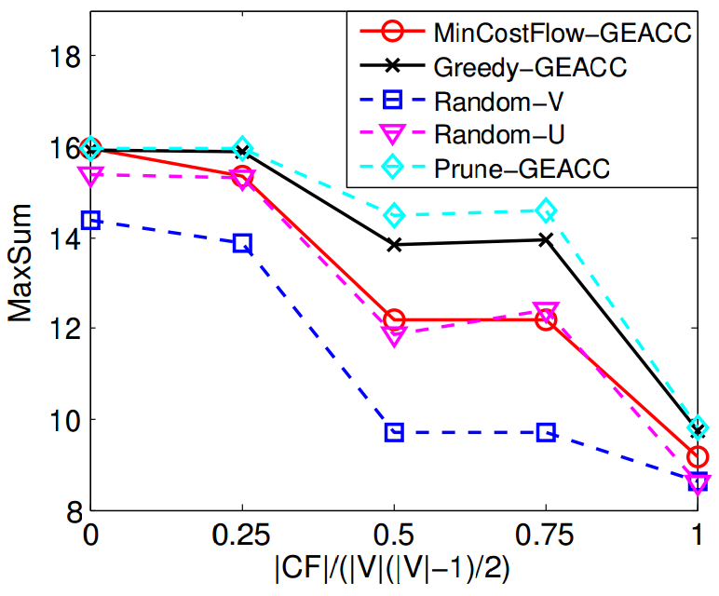
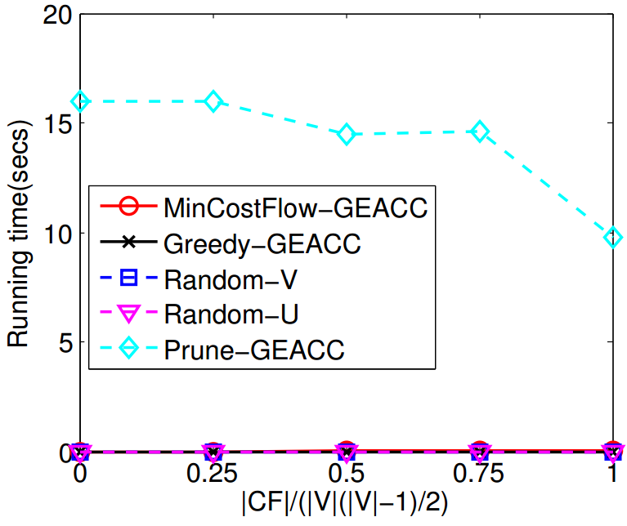

Experiments: Pruning
$\left|V\right|=5,\left|U\right|=15$

Slide 24
Conclusion
Identify a novel event-participant arrangement problem (GEACC), which is NP-hard
Design two approximate solutions and an exact solution
Extensive experiments on both real and synthetic datasets

Slide 25
Thank you

